Slide 1
Cryptography & cYBersecrity(rlmca305)-Module1
Bismi K.Charleys, Assistant Professor MCA,LMCST

Slide 2
Cryptography
Meaning: secret writing.
Definition: Cryptography is the science of protecting information by transforming it into a secure format. Cryptography is the study of Encryption.

Slide 3
Cryptography
Terminology
Plaintext: a message in its original form
Ciphertext: a message in the transformed, unreadble form
Encryption: the process for producing ciphertext from plaintext
Decryption: the reverse of encryption
Key: a secret value used to control encryption/decryption
Cryptography: study of encryption.
Cryptanalysis: study of decryption
Cryptology: Encryption + Decryption

Slide 4
Types of Cryptographic functions
Secret Key Cryptography or Symmetric Key
-One key
Public Key Cryptography or Asymmetric Key
-Two keys: public, private
Hash function
-No key

Slide 5
Secret Key Cryptography
encrypion
decryption
plaintext
ciphertext
plaintext
key
same key
key

Slide 6
Public Key Cryptography
encryption
decryption
plaintext
ciphertext
plaintext
public key
private key

Slide 7
Hash Algorithms
Message digests, one-way transformations
Message of
arbitrary length
A fixed-length
short message
Hash h

Slide 8
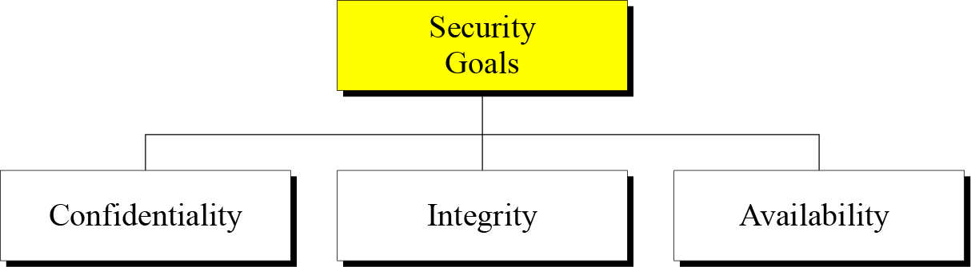
SECURITY GOALS

Slide 9
SECURITY GOALS-Confidentiality
Confidentiality-The first goal of Network Security is "Confidentiality". The function of "Confidentiality" is in protecting precious business data (in storage or in motion) from unauthorized persons.
Integrity-Information needs to be changed constantly. Integrity means that changes need to be done only by authorized entities and through authorized mechanisms
Availability-The information created and stored by an organization needs to be available to authorized entities. Information needs to be constantly changed, which means it must be accessible to authorized entities

Slide 10
Aspects of Security
consider 3 aspects of information security:
security attack
security mechanism.
security service

Slide 11
Security Attack
Attacks- Gaining the access of data by unautorized user.
Gaining means- accessing the data, modifying the data, destroying the data.
Kinds of attacks.
1)Passive attacks
2)Active attacks

Slide 12
Attacks-passive
In passive attacks, data will not be modified, only just accesed by third party. Attacks coming under passive attacks are:
1) Data interception or Release the content
2) Traffic analysis

Slide 13
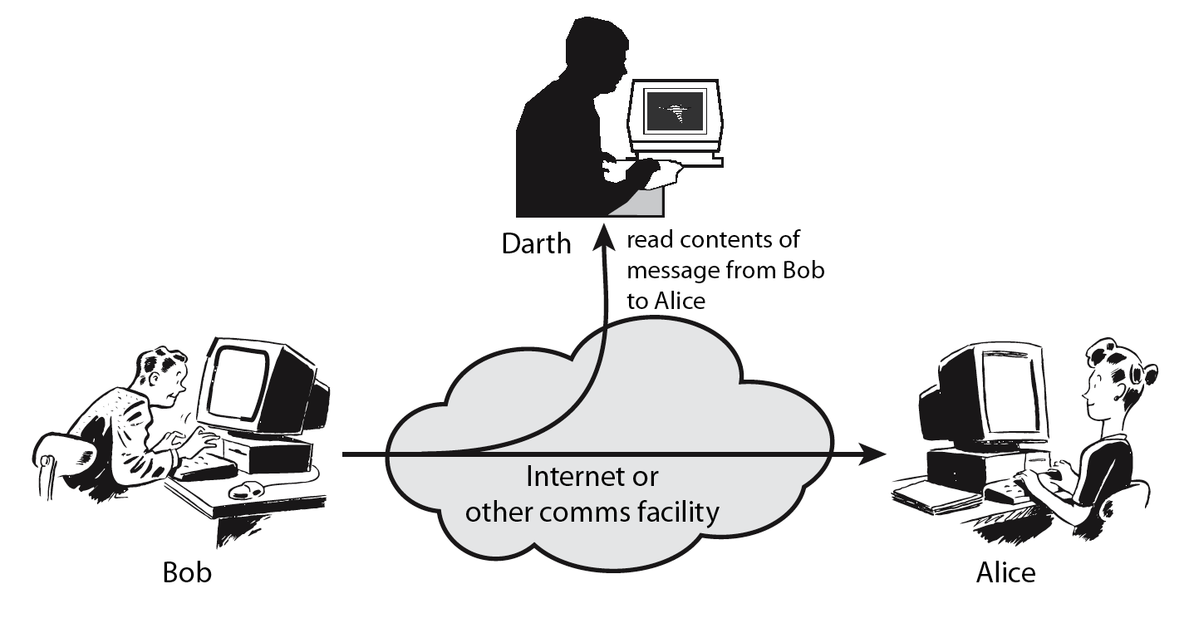
Passive Attack -Interception

Slide 14
Passive Attack: Traffic Analysis
Observe traffic pattern
Notes:
14
A useful means of classifying security attacks, used both in X.800 and RFC 2828, is in terms of passive attacks and active attacks. A passive attack attempts to learn or make use of information from the system but does not affect system resources.
Passive attacks are in the nature of eavesdropping on, or monitoring of, transmissions. The goal of the opponent is to obtain information that is being transmitted. Two types of passive attacks are:
+ release of message contents - as shown above in Stallings Figure 1.2a here
+ traffic analysis - monitor traffic flow to determine location and identity of communicating hosts and could observe the frequency and length of messages being exchanged
These attacks are difficult to detect because they do not involve any alteration of the data.

Slide 15
Active Attacks
In active attacks modification will done on the data by unauthorized user.
Types of active atacks
1.Masquerade
2. Replay
3.Data Modification
4.Denial Of Services

Slide 16
Masquerade
Third party
Sends the data in the name of sender
Sender
Receiver

Slide 17
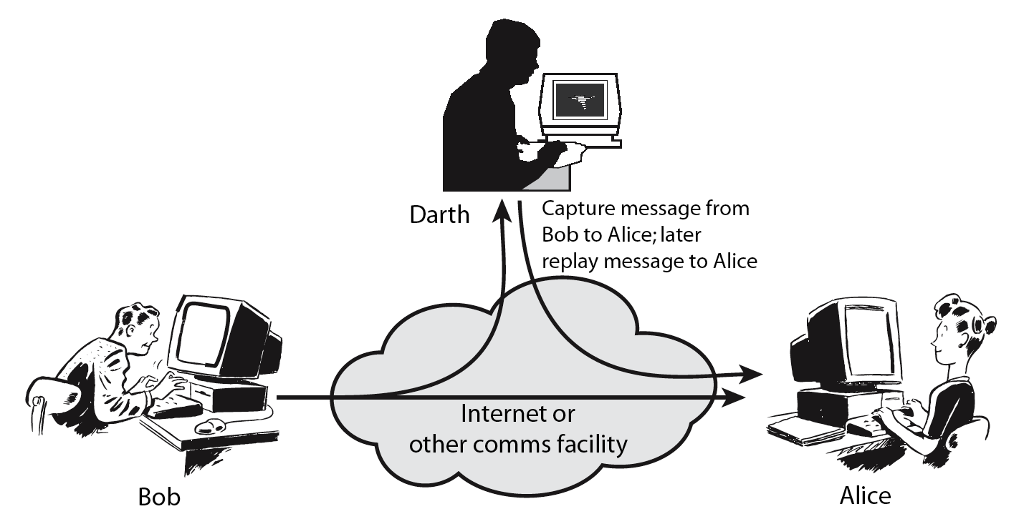
Active Attack: Replay
Notes:
17
Active attacks involve some modification of the data stream or the creation of a false stream and can be subdivided into four categories: masquerade, replay, modification of messages, and denial of service:
masquerade of one entity as some other
replay previous messages (as shown above in Stallings Figure 1.3b)
modify/alter (part of) messages in transit to produce an unauthorized effect
denial of service - prevents or inhibits the normal use or management of communications facilities
Active attacks present the opposite characteristics of passive attacks. Whereas passive attacks are difficult to detect, measures are available to prevent their success. On the other hand, it is quite difficult to prevent active attacks absolutely, because of the wide variety of potential physical, software, and network vulnerabilities. Instead, the goal is to detect active attacks and to recover from any disruption or delays caused by them.

Slide 18
Data Modification
Third party
Data modified
Data accessed
Sender
Receiver

Slide 19
Denial Of Service
Third party
disrupts the service sends by the server
Sender
Server

Slide 20
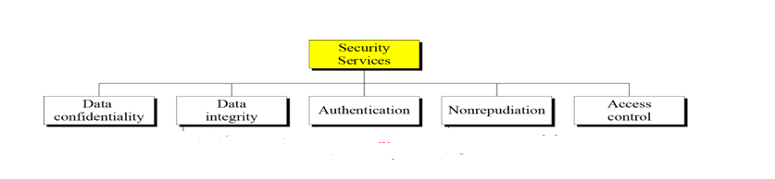
Security Services
enhance security of data processing systems and information transfers of an organization
intended to counter security attacks.

Slide 21
Security Services
1) Access Control: prevent unauthorized access to resources.
2) Authentication: verification of user identity or we can say authentication assures recipient that the message is from the source that it claims to be from.
3) Confidentiality: protection of data from unauthorized disclosure.
4) Integrity: no modification should be done during transmission
5) Non-Repudiation: protection against denial of sending or receiving in the communication

Slide 22
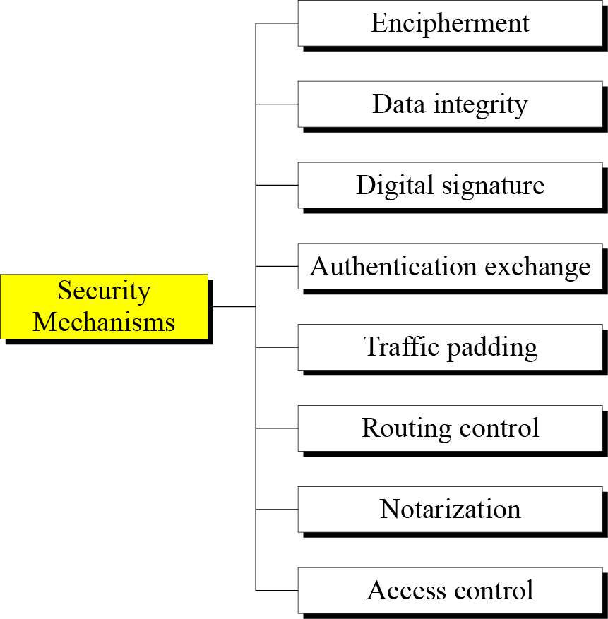
Security Mechanisms
Security mechanisms are technical tools and techniques used to implement security services. Different security mechanisms are

Slide 23
Security Mechanisms
Encipherment- It is the process of translating plain text into cipher text. This is hiding or covering of data which provides confidentiality. Cryptography and Steganography are used for enciphering
Data Integrity- This is the assurance that data has not been modified
Digital Signature- A digital signature is a means by which the sender can electronically sign the data and the receiver can electronically verify the signature. Public and private keys can be used.
Authentication exchange- In this two entities exchange some messages to prove their identity to each other
Traffic Padding- This is insertion of bits in a data to prevent traffic analysis.
Notarization-This is the use of a trusted third party to assure properties a data exchage.
Routing control means selecting and continuously changing different available routes between sender and receiver to prevent the opponent from eavesdropping on a particular route.

Slide 24
Phishing
Phishing is the fraudulent use of electronic communications to deceive and take advantage of users. Phishing attacks attempt to gain sensitive, confidential information such as usernames, passwords, credit card information, network credentials, and more. By posing as a legitimate individual or institution via phone or email, cyber attackers use social engineering to manipulate victims into performing specific actions—like clicking on a malicious link or attachment—or willfully divulging confidential information.
https://youtu.be/lc7scxvKQOo

Slide 25
Phishing Methods
Through link manipulation, an email may present with links that spoof legitimate URLs; manipulated links may feature subtle misspellings or use of a subdomain.
Phishing scams may use website forgery, which employs JavaScript commands to make a website URL look legitimate.
Using covert redirection, attackers can corrupt legitimate websites with malicious pop-up dialogue boxes that redirect users to a phishing website.
Infected attachments, such as .exe files, Microsoft Office files, and PDF documents can install ransomware or other malware.
Phishing scams can also employ phone calls, text messages, and social media tools to trick victims into providing sensitive information.

Slide 26
Ransomware
Ransomware is malicious software that infects your computer and displays messages demanding a fee to be paid in order for your system to work again. This class of malware is a criminal moneymaking scheme that can be installed through fraudulent links in an email message, instant message or website.

Slide 27
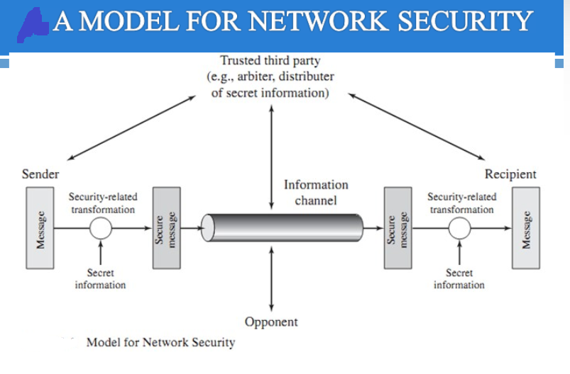
OSI security architecture

Slide 28
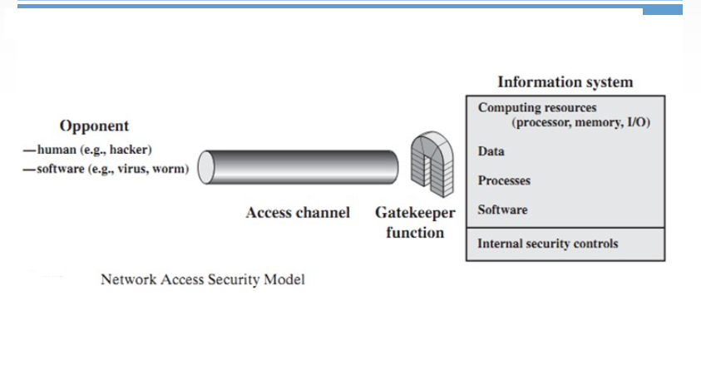
OSI security architecture

Slide 29
Classical Encryption Techniques
Symmetric Encryption
or conventional / private-key / single-key
sender and recipient share a common key
all classical encryption algorithms are private-key
was only type prior to invention of public-key in 1970’s
and by far most widely used (still)
is significantly faster than public-key crypto

Slide 30
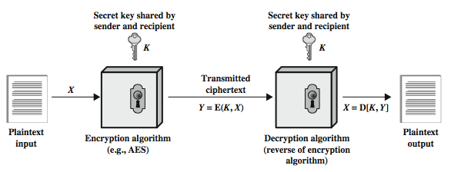
Symmetric Cipher Model

Slide 31
Requirements
two requirements for secure use of symmetric encryption:
a strong encryption algorithm
a secret key known only to sender / receiver
mathematically have:
Y = E(K, X) = E_{K}(X) = {X}_{K}
X = D(K, Y) = D_{K}(Y)
assume encryption algorithm is known
Kerckhoff’s Principle: security in secrecy of key alone, not in obscurity of the encryption algorithm
implies a secure channel to distribute key
Central problem in symmetric cryptography

Slide 32
Classical Ciphers
Substitution cipher: replacing each element of the plaintext with another element.
Transposition (or permutation) cipher: rearranging the order of the elements of the plaintext.

Slide 33
Substitution Ciphers- Caesar Cipher
earliest known substitution cipher
by Julius Caesar
first attested use in military affairs
replaces each letter by 3rd letter on
example:
meet me after the toga party
PHHW PH DIWHU WKH WRJD SDUWB

Slide 34
Caesar Cipher
can define transformation as:
a b c d e f g h i j k l m n o p q r s t u v w x y z = IN
D E F G H I J K L M N O P Q R S T U V W X Y Z A B C = OUT
mathematically give each letter a number
a b c d e f g h i j k l m n o p q r s t u v w x y z
0 1 2 3 4 5 6 7 8 9 10 11 12 13 14 15 16 17 18 19 20 21 22 23 24 25
then have Caesar (rotation) cipher as:
c = E(k, p) = (p + k) mod (26)
p = D(k, c) = (c – k) mod (26)

Slide 35
Playfair Cipher
not even the large number of keys in a monoalphabetic cipher provides security
one approach to improving security was to encrypt multiple letters
the Playfair Cipher is an example
invented by Charles Wheatstone in 1854, but named after his friend Baron Playfair

Slide 36
Playfair Key Matrix
a 5X5 matrix of letters based on a keyword
fill in letters of keyword (sans duplicates)
fill rest of matrix with other letters
eg. using the keyword MONARCHY
M | O | N | A | R
C | H | Y | B | D
E | F | G | I/J | K
L | P | Q | S | T
U | V | W | X | Z

Slide 37
Encryption using Playfair
plaintext is encrypted two letters at a time
if a pair is a repeated letter, insert filler like 'X’
if both letters fall in the same row, replace each with letter to right (wrapping back to start from end)
if both letters fall in the same column, replace each with the letter below it (wrapping to top from bottom)
otherwise each letter is replaced by the letter in the same row and in the column of the other letter of the pair

Slide 38
Playfair Example
Message = Move forward
Plaintext = mo ve fo rw ar dx
Here x is just a filler, message is padded and segmented
mo -> ON; ve -> UF; fo -> PH, etc
Ciphertext = ON UF PH NZ RM BZ

Slide 39
Security Of Playfair Cipher
security much improved over monoalphabetic
since have 26 x 26 = 676 digrams
would need a 676 entry frequency table to analyse (versus 26 for a monoalphabetic)
and correspondingly more ciphertext
was widely used for many years
eg. by US & British military in WW1
it can be broken, given a few hundred letters
since still has much of plaintext structure

Slide 40
Vigenère Cipher
Vigenere Cipher is a method of encrypting alphabetic text. It uses a simple form of polyalphabetic substitution. A polyalphabetic cipher is any cipher based on substitution, using multiple substitution alphabets .The encryption of the original text is done using the Vigenère square or Vigenère table. The table consists of the alphabets written out 26 times in different rows, each alphabet shifted cyclically to the left compared to the previous alphabet, corresponding to the 26 possible Caesar Ciphers.
At different points in the encryption process, the cipher uses a different alphabet from one of the rows.
The alphabet used at each point depends on a repeating keyword.

Slide 41
Vigenère Cipher
Input : Plaintext : GEEKSFORGEEKS
Keyword : AYUSH
Output : Ciphertext : GCYCZFMLYLEIM
For generating key, the given keyword is repeated in a circular manner until it matches the length of the plain text. The keyword "AYUSH" generates the key "AYUSHAYUSHAYU" The plain text is then encrypted using the process explained below.

Slide 42
Vigenère Cipher
Encryption
The first letter of the plaintext, G is paired with A, the first letter of the key. So use row G and column A of the Vigenère square, namely G. Similarly, for the second letter of the plaintext, the second letter of the key is used, the letter at row E and column Y is C. The rest of the plaintext is enciphered in a similar fashion.

Slide 43
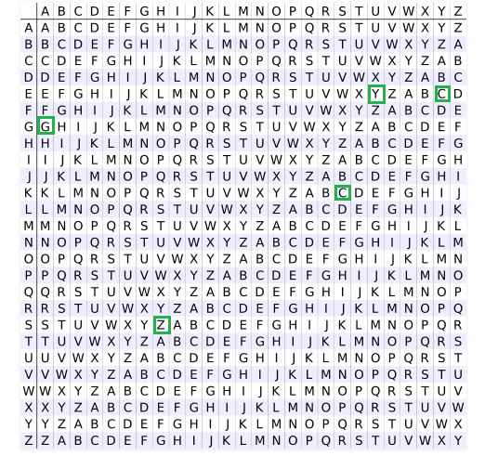
Vigenère Cipher

Slide 44
Transposition Ciphers
now consider classical transposition or permutation ciphers
these hide the message by rearranging the letter order
without altering the actual letters used
can recognise these since have the same frequency distribution as the original text

Slide 45
Rail Fence cipher
Message: “meet me after the toga party”
write message letters out diagonally over a number of rows
then read off cipher row by row
eg. write message out as:
m e m a t r h t g p r y
e t e f e t e o a a t
giving ciphertext
MEMATRHTGPRYETEFETEOAAT

Slide 46
Row Transposition Ciphers
is a more complex transposition
write letters of message out in rows over a specified number of columns
then reorder the columns according to some key before reading off the rows
Key: 4312567
Column Out 4 3 1 2 5 6 7
Plaintext: a t t a c k p
o s t p o n e
d u n t i l t
w o a m x y z
Ciphertext: TTNAAPTMTSUOAODWCOIXKNLYPETZ

Slide 47
Steganography
Steganography is a method of hiding secret data, by embedding it into an audio, video, image or text file. ... It is one of the methods employed to protect secret or sensitive data from malicious attacks.
The word Steganography is derived from two Greek words- ‘stegos’ meaning ‘to cover’ and ‘grayfia’, meaning ‘writing’, thus translating to ‘covered writing’, or ‘hidden writing’.
Cryptography and steganography are both methods used to hide or protect secret data. However, they differ in the respect that cryptography makes the data unreadable, or hides the meaning of the data, while steganography hides the existence of the data.

